Slide 1


INSTITUTE FOR ADVANCED COMPUTING AND
SOFTWARE
DEVELOPMENT AKURDI, PUNE
Documentation On
“ US Federal Campaign Finance Data Analysis Using Big Data Technologies ”
PG-DBDA MARCH 2022
Submitted By:
Group No: 06
UMESH GANESH BHARUDE 223313
Mr. Prashant Karhale Mr. Akshay Tilekar
Center Coordinator Project Guide

Slide 2
PROBLEM STATEMENT
To analyze the campaign finance & contributions (individuals & PACs) for all federal elections over the last 2 decades & a half.
INTRODUCTION
US FEDERAL CAMPAIGN FINANCE DATA ANALYSIS using AWS services like S3 Bucket, EMR, CFT, Spark, Hive and PowerBI. To analyze the historical data of US Federal Campaign's finance and contributions made individually and through PACs. I have determined the relationship between various features and their impact on contribution patterns for candidates. Performed ETL in Apache Spark and displayed respective visualizations in Power BI.

Slide 3





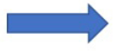






ARCHITECTURE DIAGRAM

Slide 4
TOOLS & TECHNOLOGIES
S3 → Storing raw data
Extract data from Kaggle and storing in Amazon S3 Bucket
CFT : Creating EMR
EMR : Apache Hadoop Ecosystem: a. HDFS → Using Hadoop distributed file system for data storage
b. Apache PySpark → Combine various tables for proper analysis and performing ETL
c. Apache Hive → To process structured Data
5. Languages to use: a. Python → ETL and Data Processing
b. HQL → Creating Hive tables and loading data
c. Shell Script → Automation
6. File Formats to be used: a. CSV b. Parquet
7.Power BI: Creating Dashboard

Slide 5
The dataset I have taken from kaggle.
Below is the following steps how I imported the data and store the shell script file in s3 bucket
1) Upload dataset from kaggle to EMR:
Go to the kaggle website.
Click on Your profile button on the top right and then select My Account.
Scroll down to the API section and click on the Create New API Token button.
It will download the file kaggle.json & Save the file at a known location on your machine.
Move the downloaded file to a location: ~/.kaggle/kaggle.json.
Create .kaggle folder in your home directory, you can create one using the command: mkdir ~/.kaggle
Now move the downloaded file to this location using:
mv <location>/kaggle.json ~/.kaggle/kaggle.json
You need to give proper permissions to the file:
chmod 600 ~/.kaggle/kaggle.json
The run the command as ...> kaggle competitions list

Slide 6
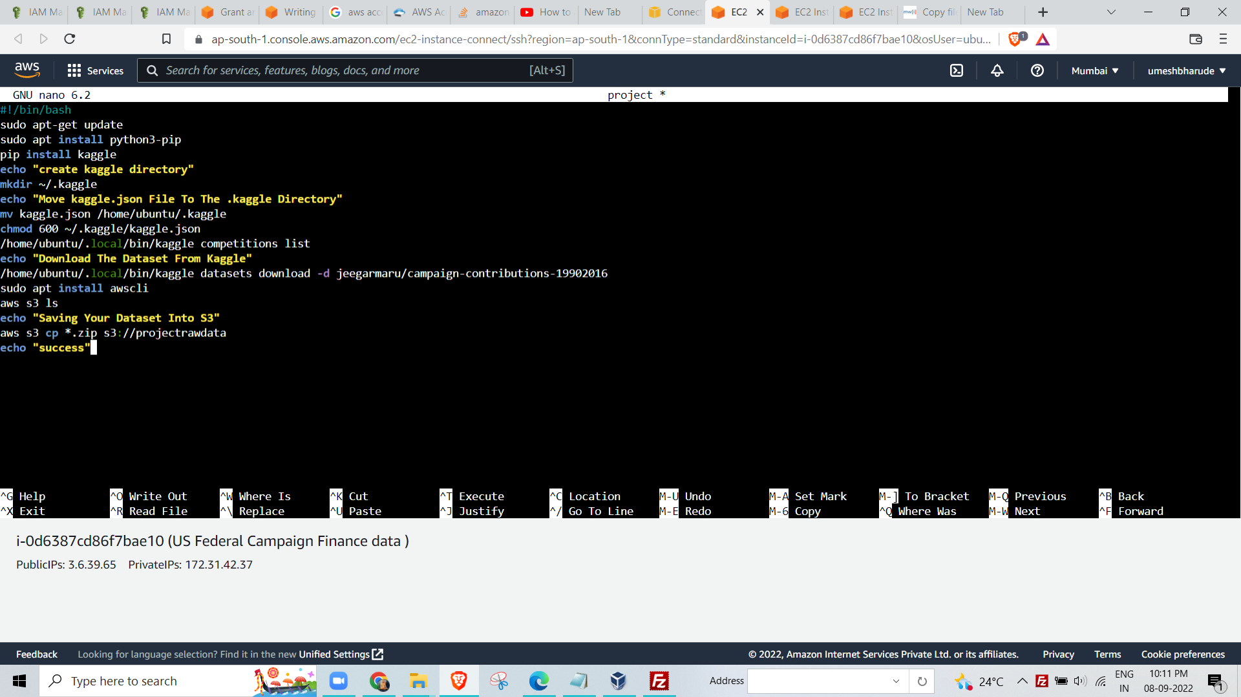

Slide 7
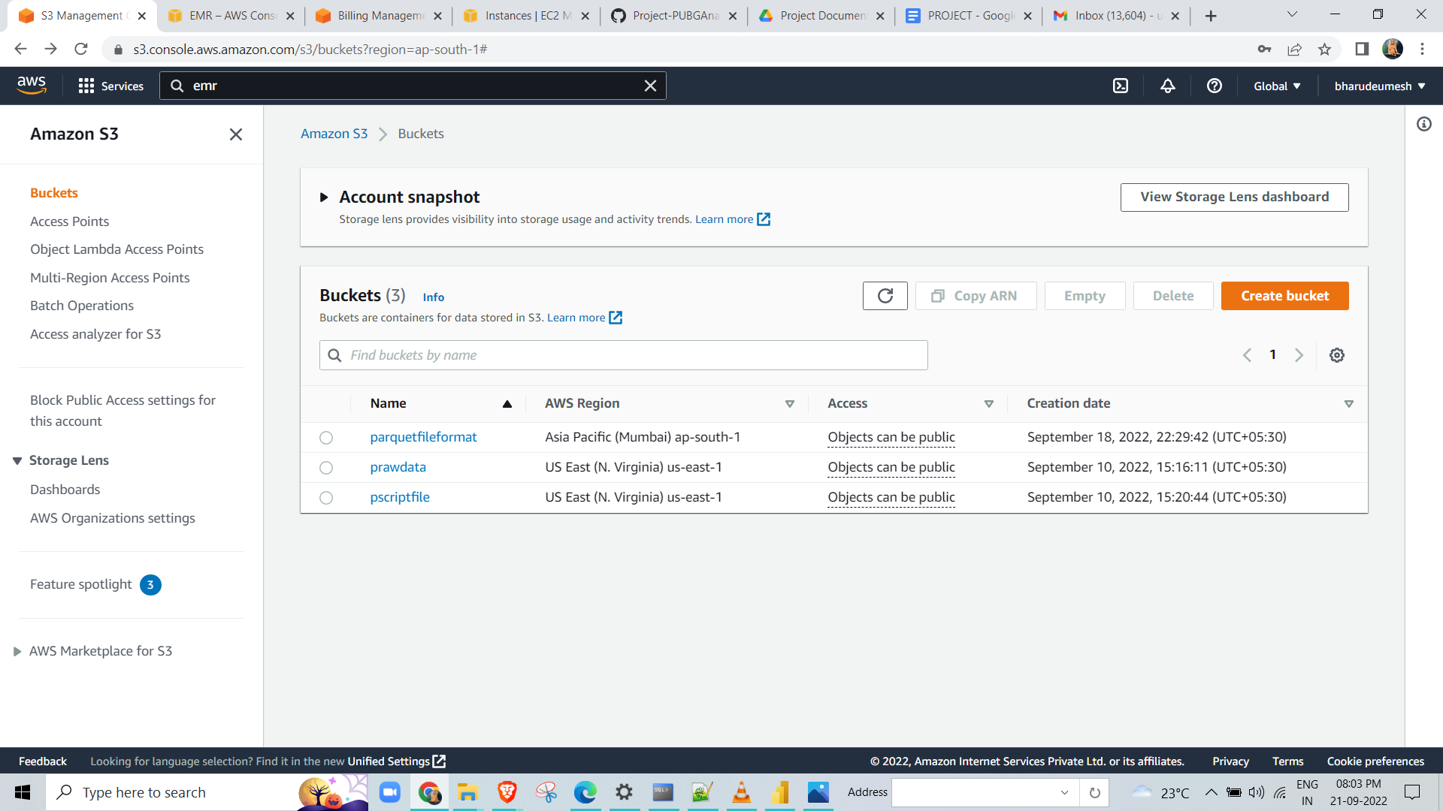
I Run the above shell script
The raw data is download and
Then the raw data is store in s3 bucket
I also store the shell script file in s3 bucket

Slide 8
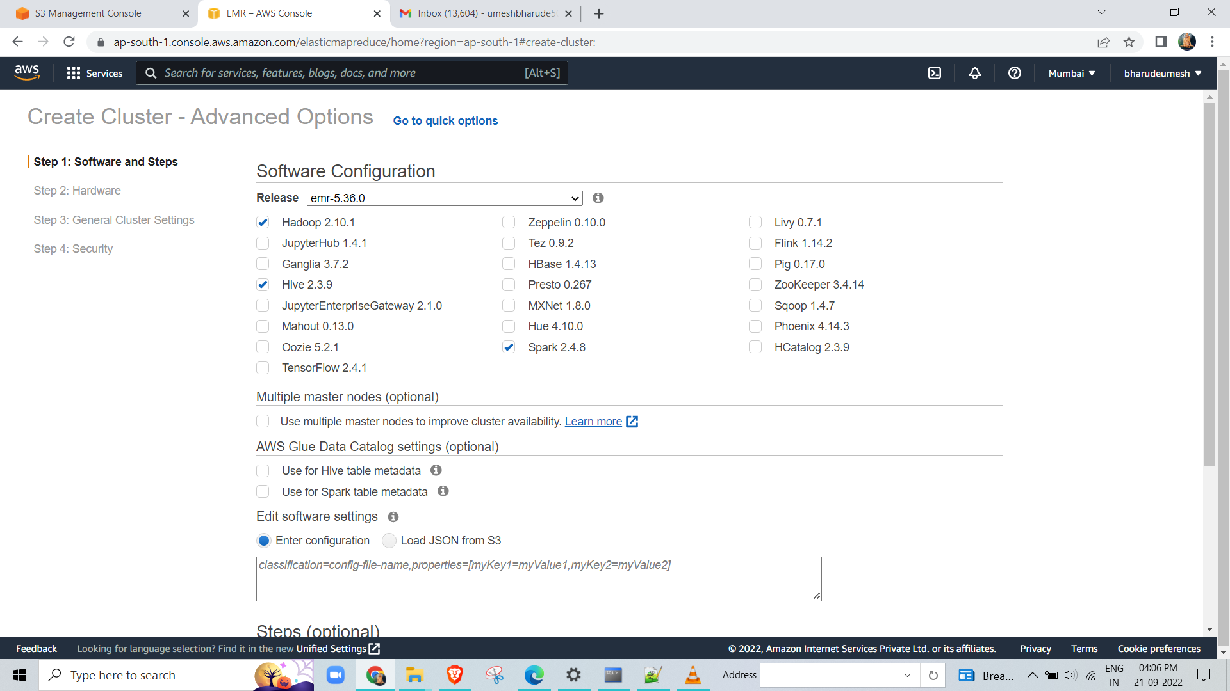
create the emr cluster and I choose services hadoop, spark and hive:

Slide 9
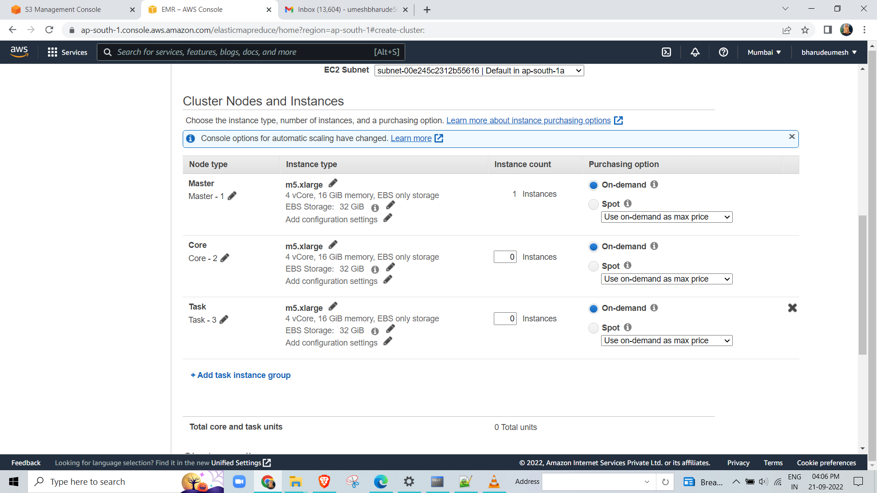
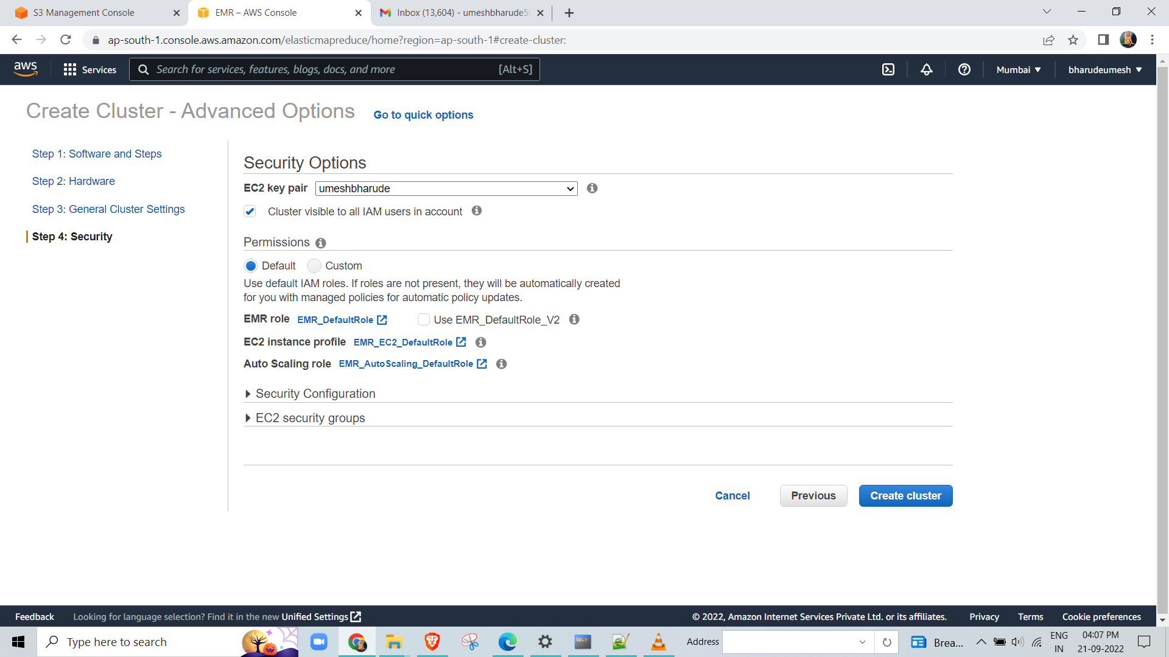

Slide 10
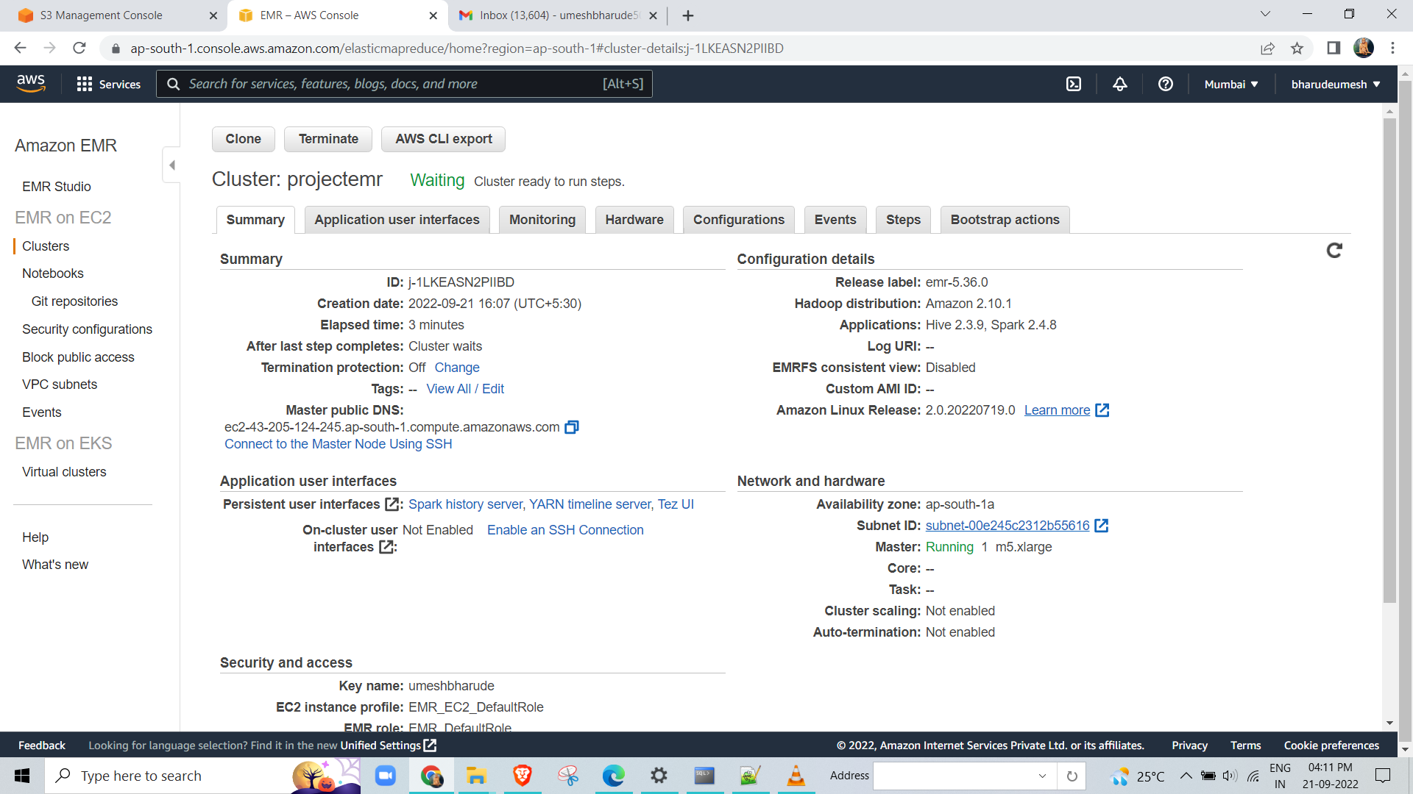

Slide 11
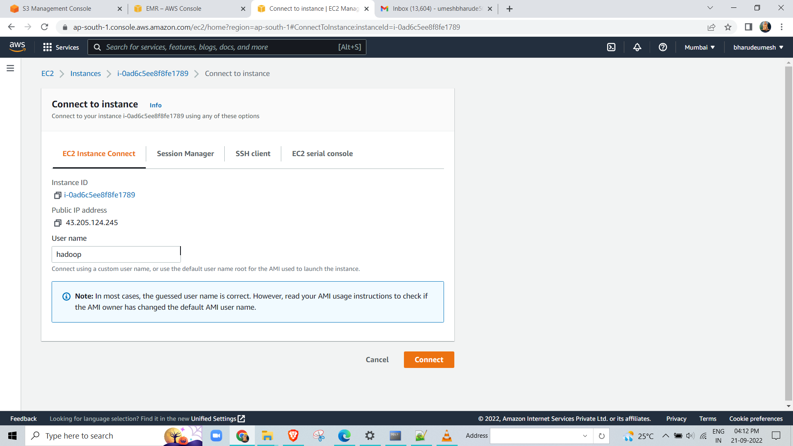
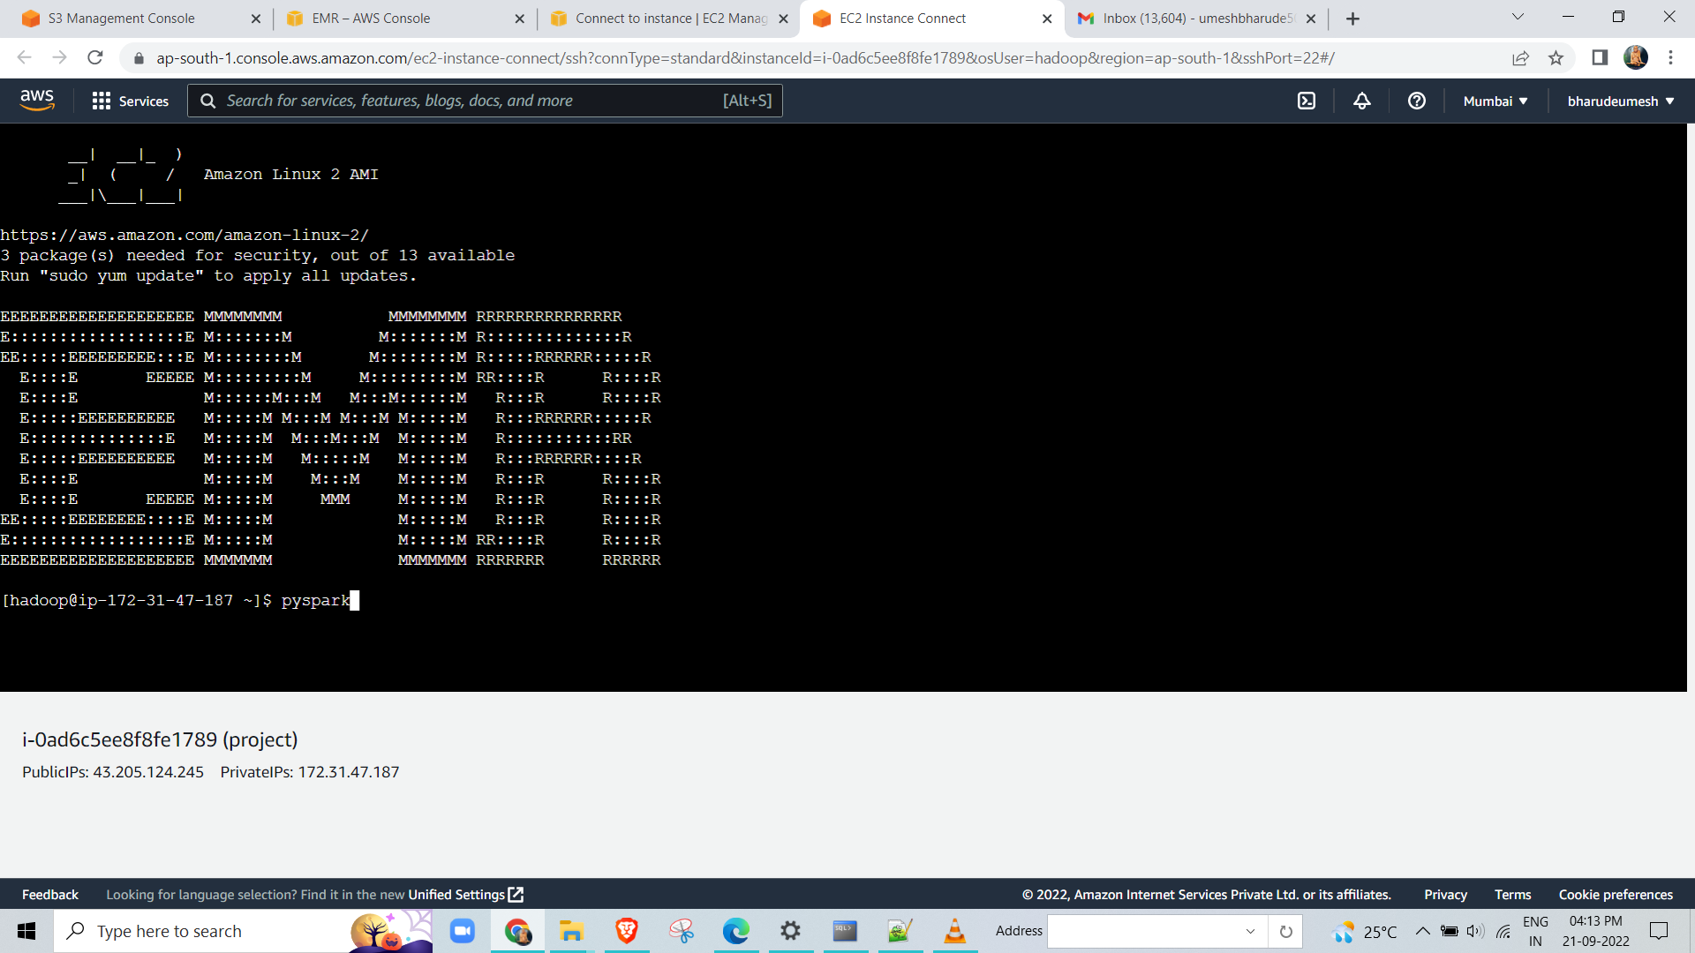

Slide 12
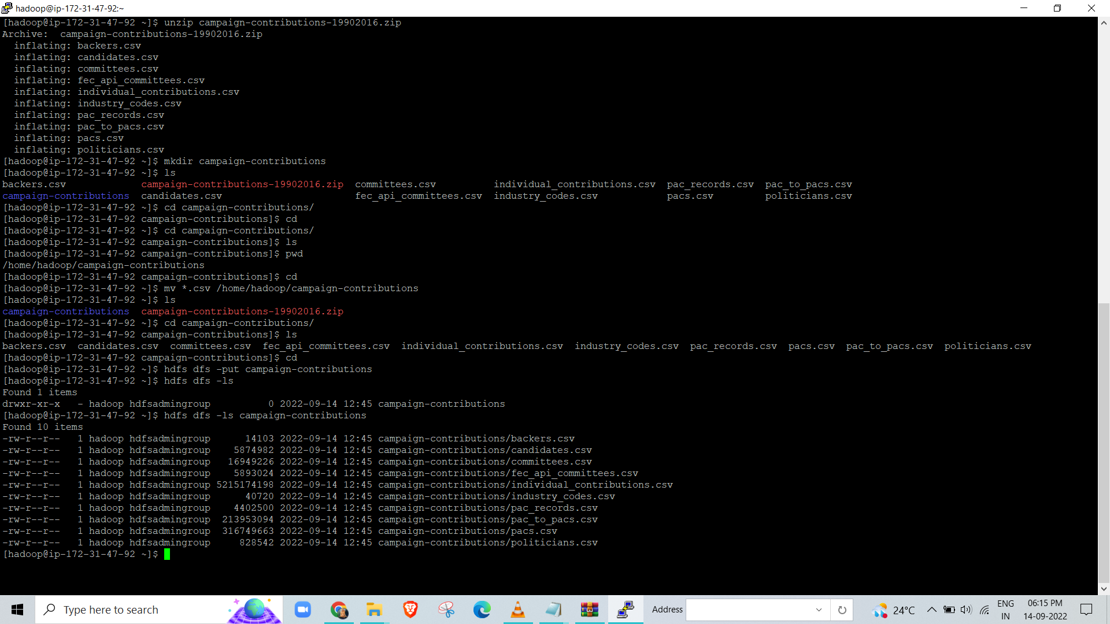
I copy the data from s3 bucket to emr:
By using the command
aws s3 <path of bucket> ./
Then we unzip the data and store data in hdfs by using command :
$ hdfs dfs -put <directory name >

Slide 13
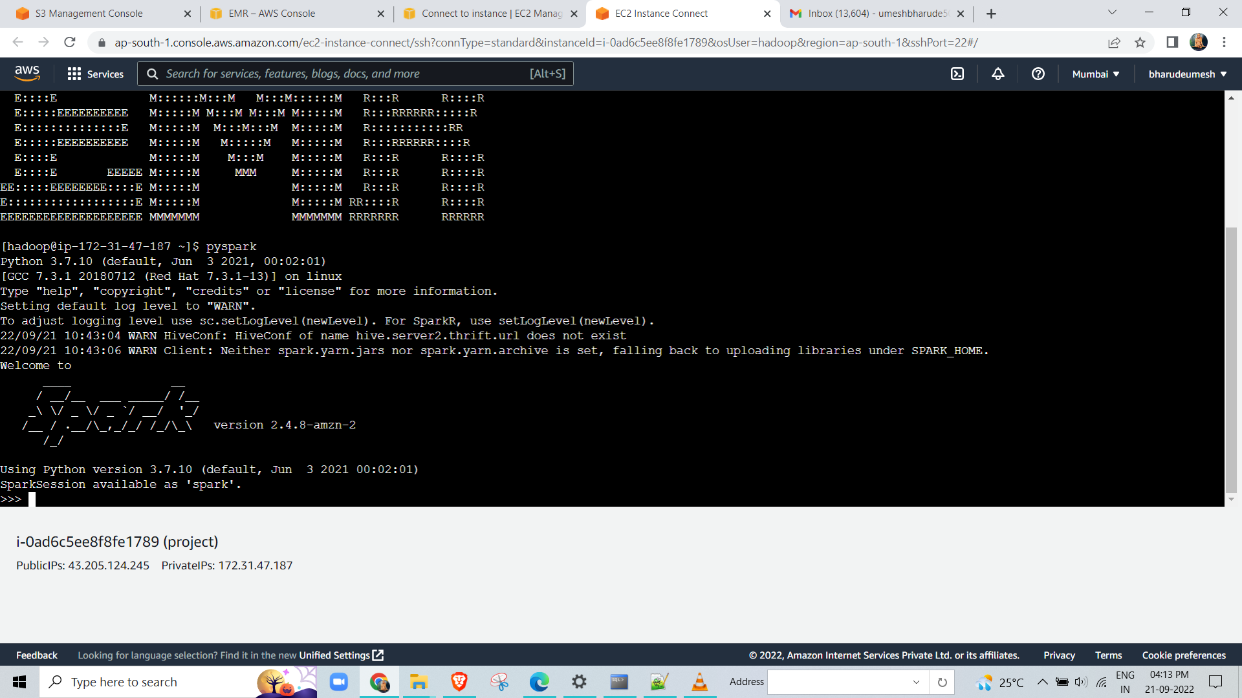
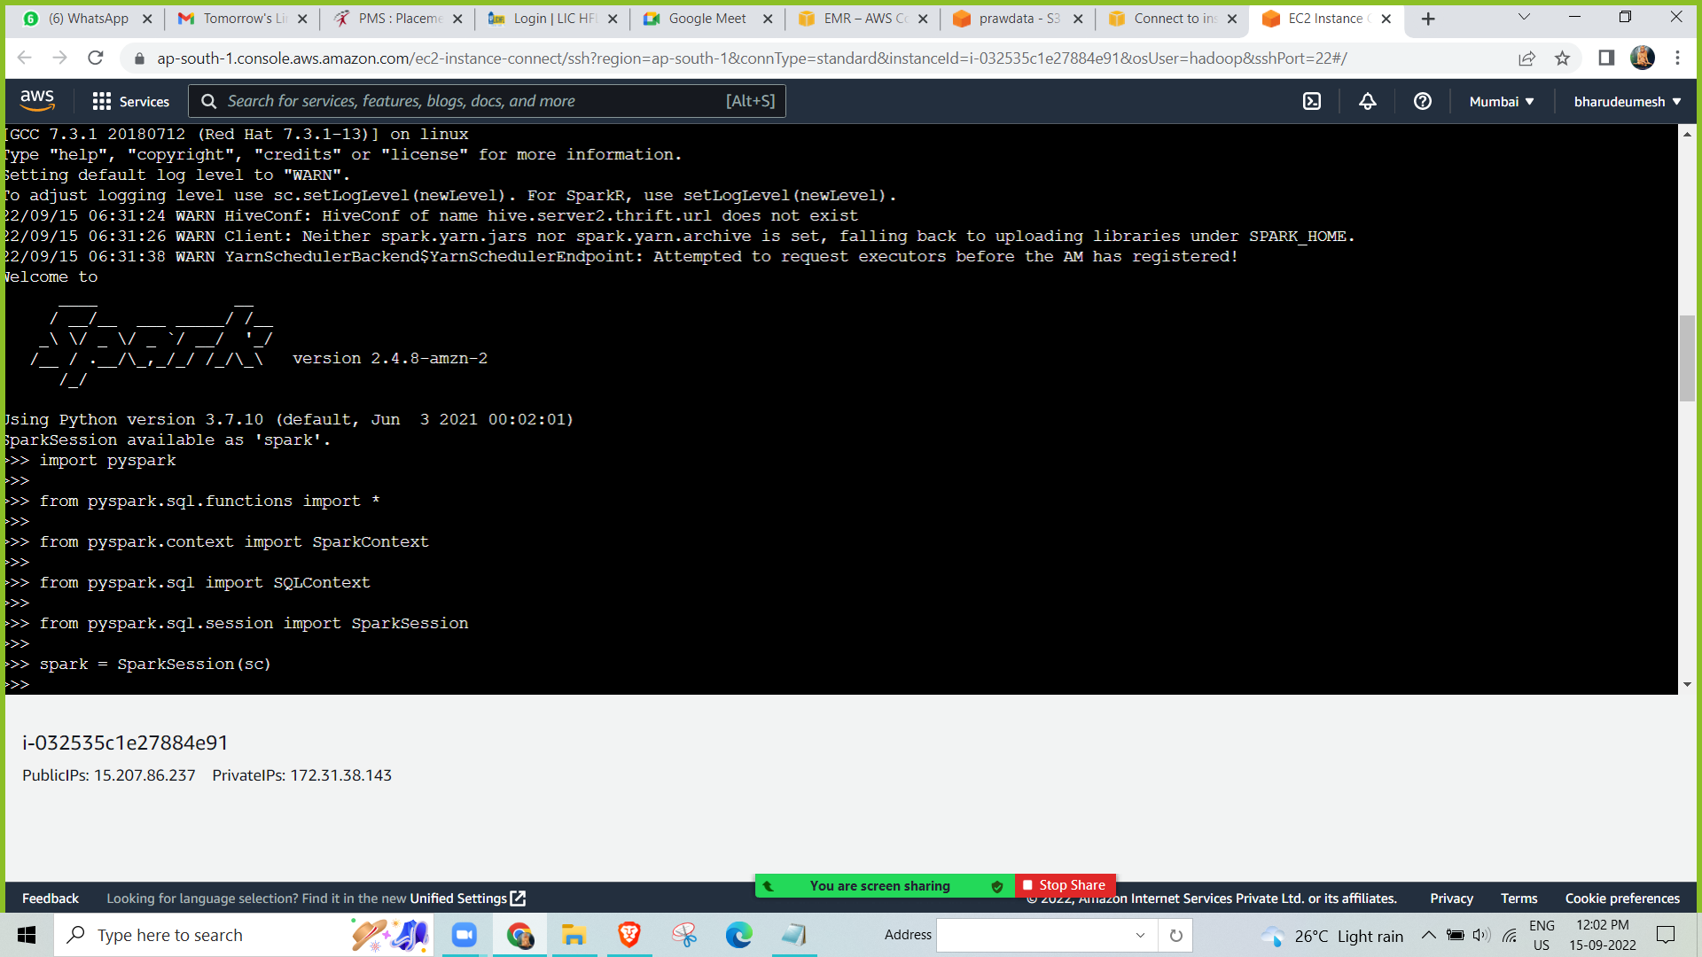
Go to the pyspark on HDFS
Command ===> pyspark
we install the libraries in pyspark:

Slide 14
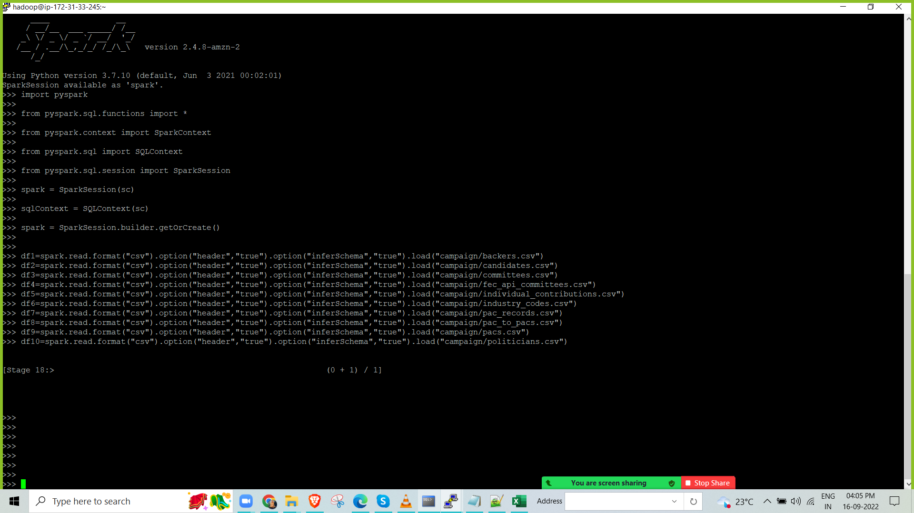
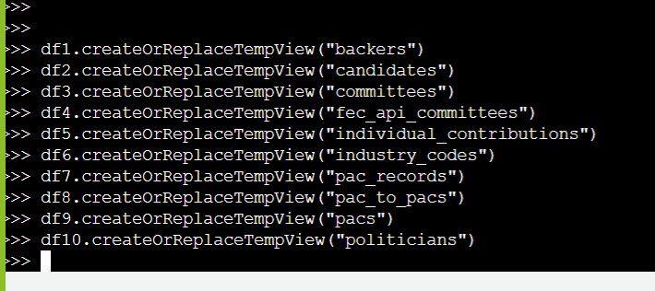
creating dataframe
creating temp view of tables

Slide 15
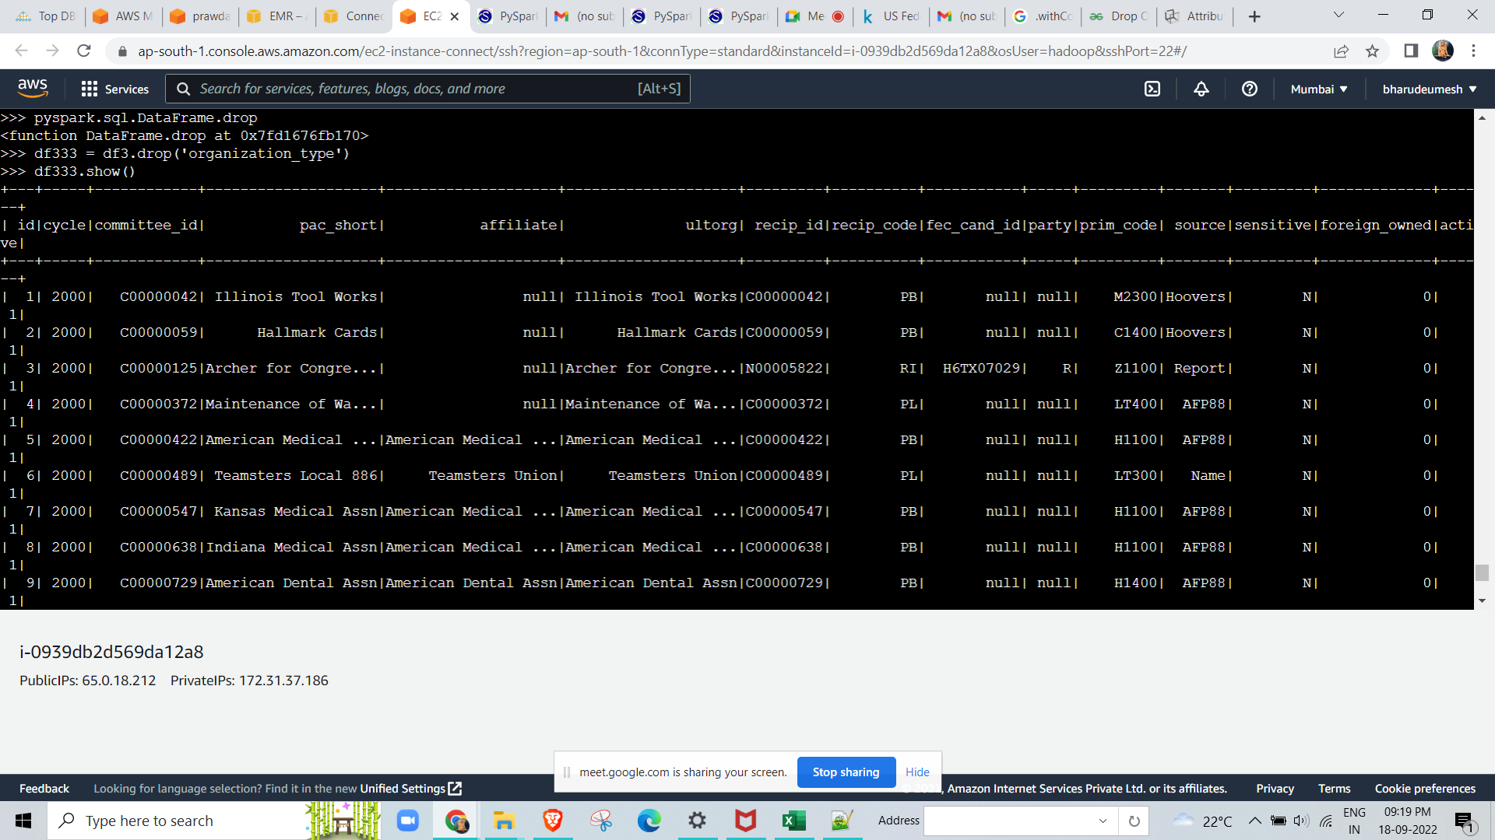
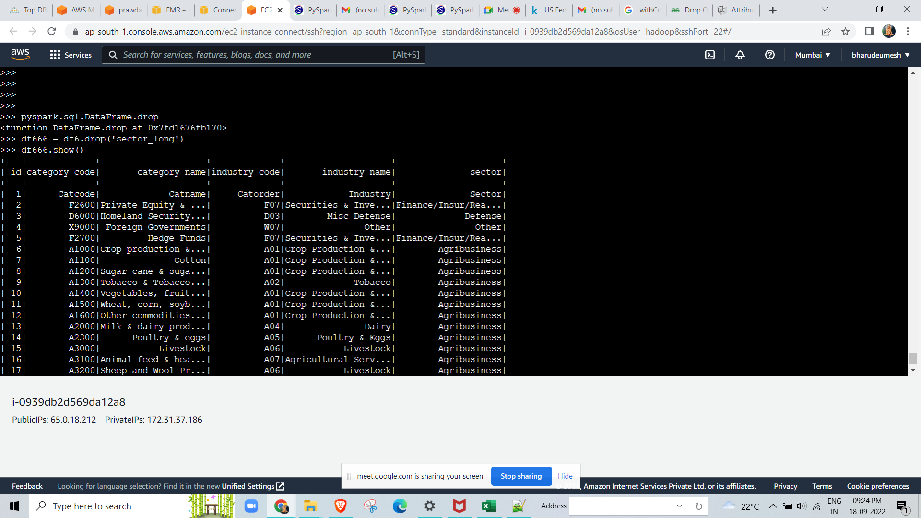

Slide 16
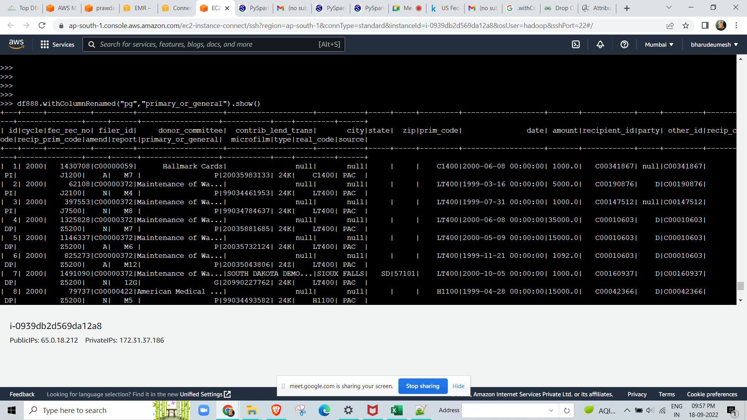
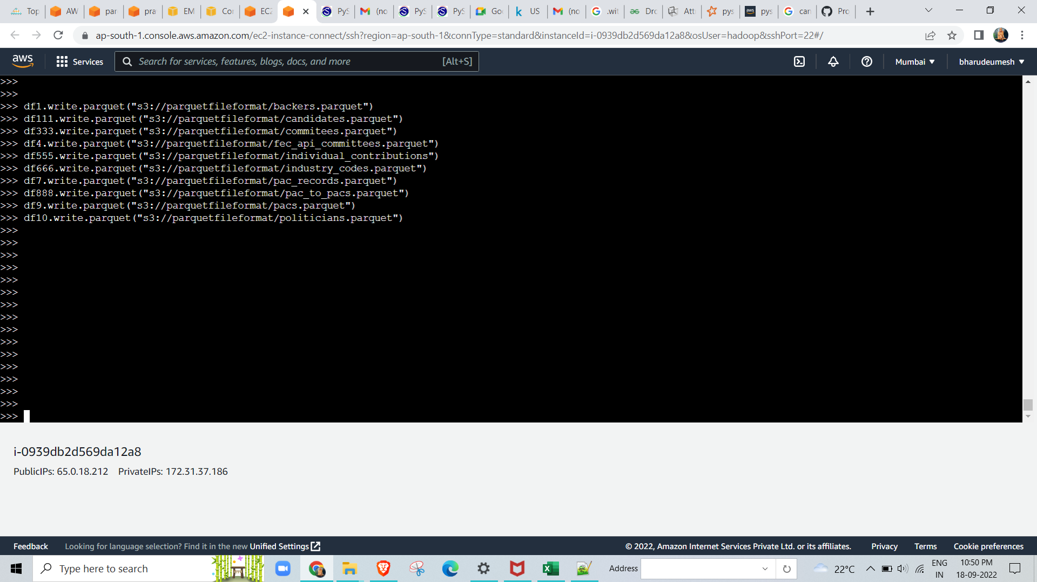
I renamed the column:
Save the cleaned data in S3 Bucket into parquet format:

Slide 17
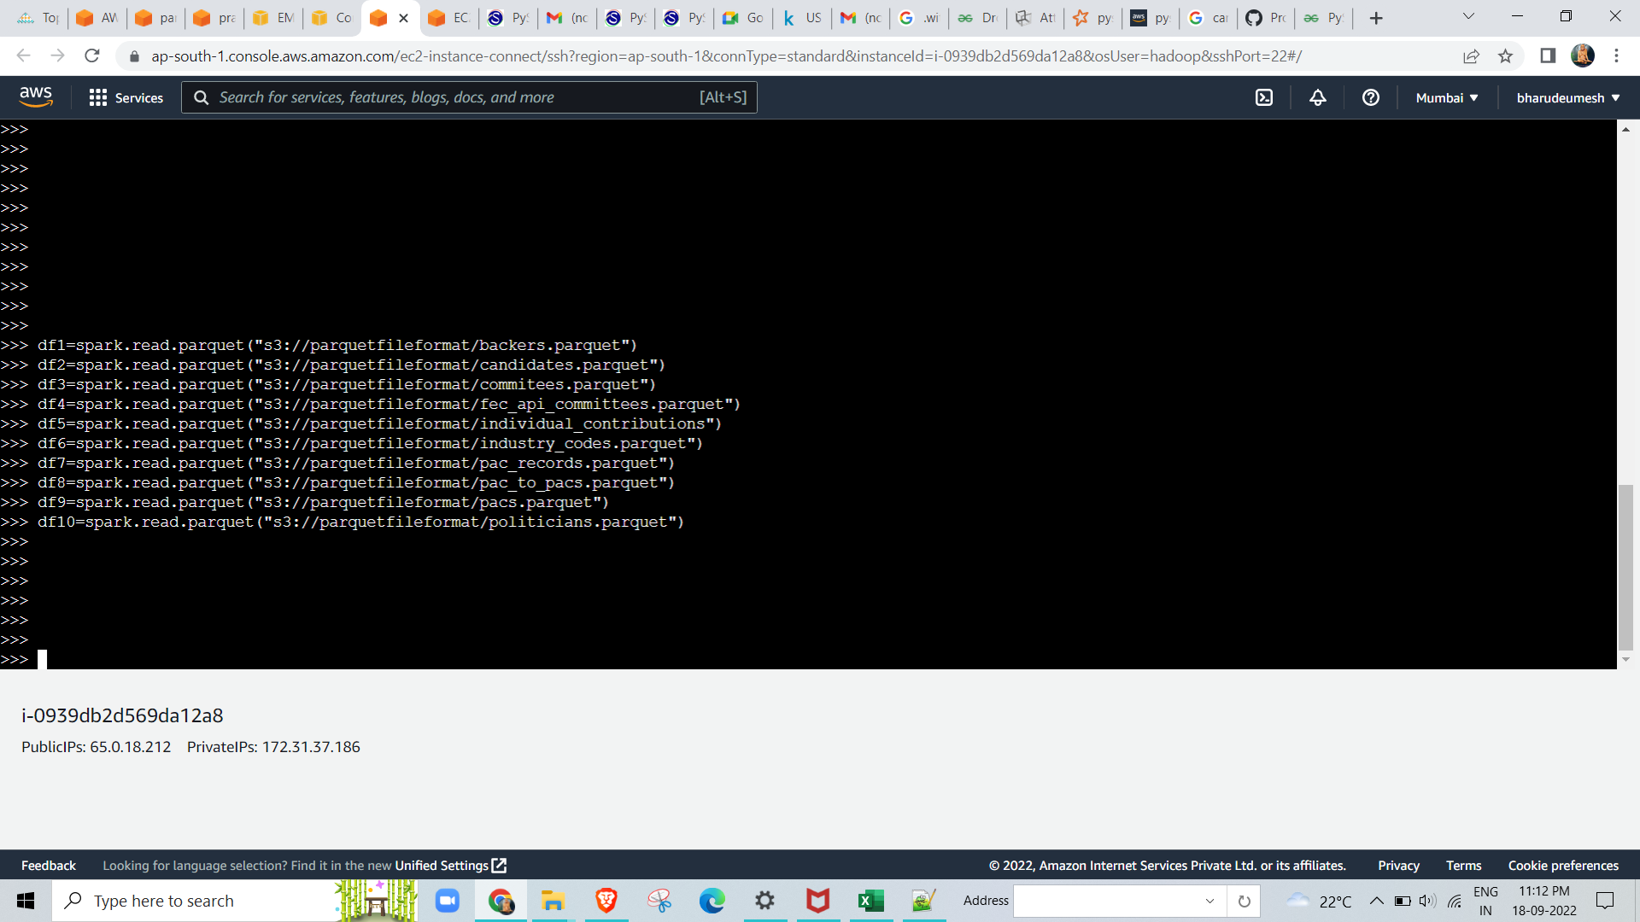
Load the data from S3 to pyspark:

Slide 18
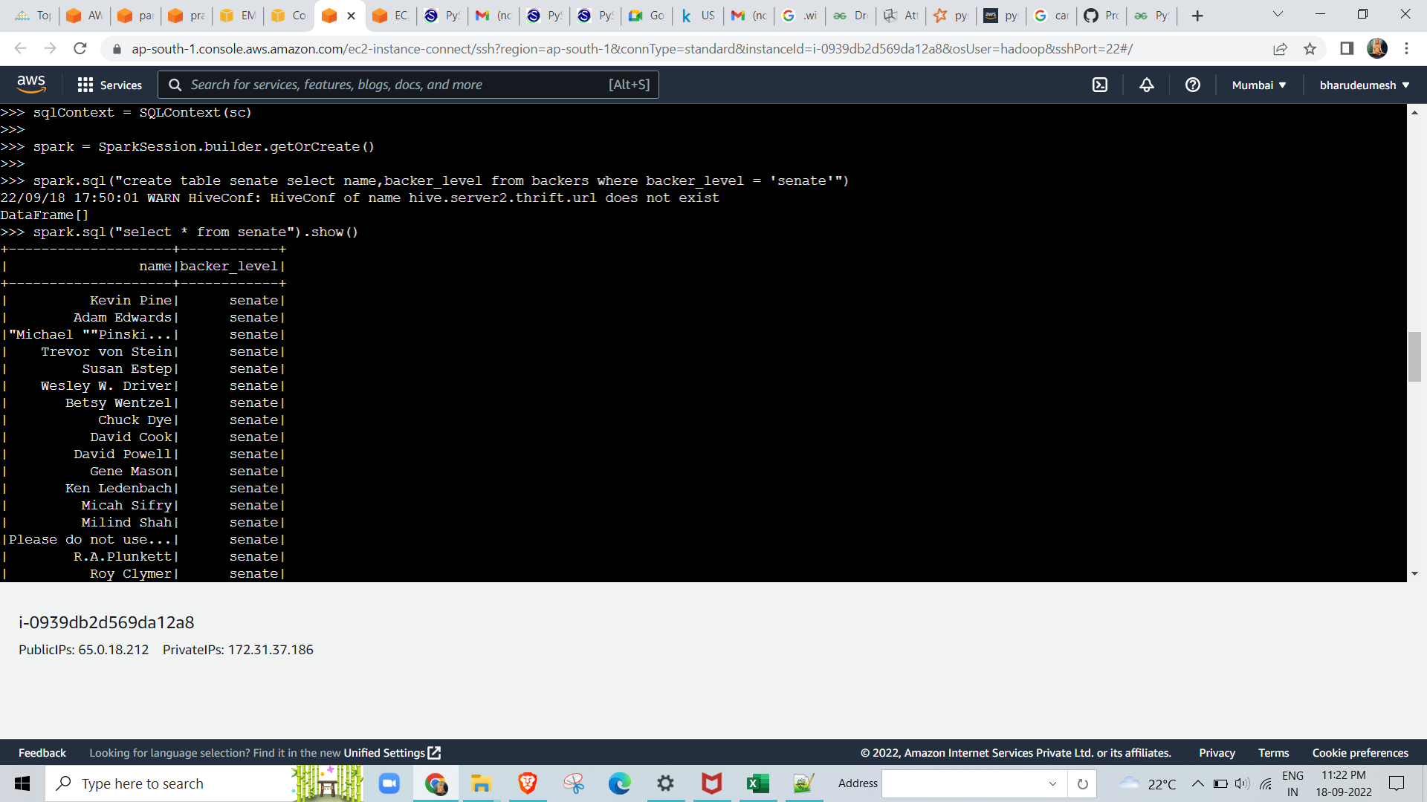
Create table and perform query in pyspark and store table in hive :
>>> df1.count() 370 | >>> df2.count() 67999 | >>> df3.count() 157542 | >>> df4.count() 45507 | >>> df5.count() 24446421
>>> df6.count() 444 | >>> df7.count() 44628 | >>> df8.count() 1083525 | >>> df9.count() 3539657 | >>> df10.count() 26047

Slide 19
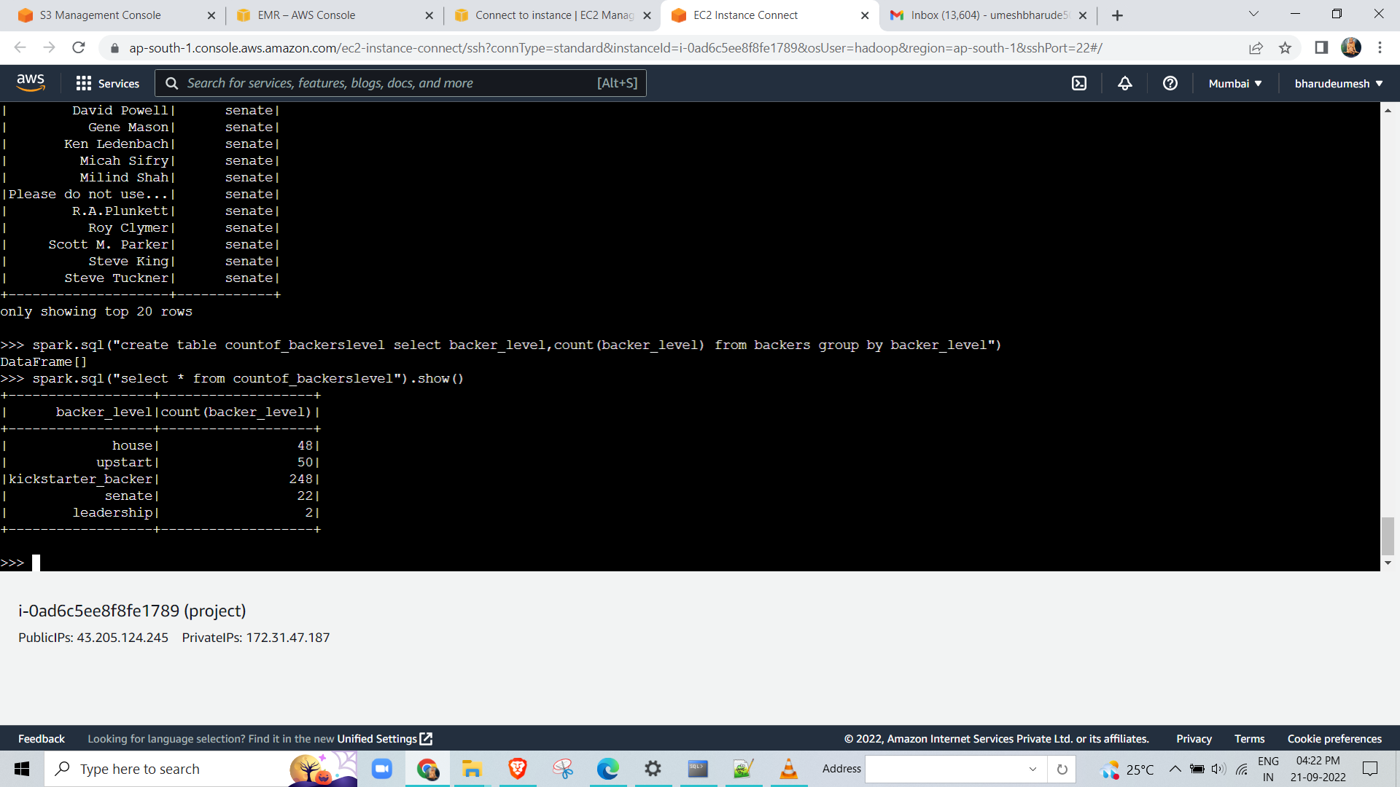
spark.sql("create table cycleof_candidates select b.cid,c.cycle,b.name,party from backers b join candidates c where c.cycle=1996 and b.cid=c.cid")
spark.sql("select * from cycleof_candidates").show()
+---------+-----+--------------------+-----+
| cid|cycle| name|party|
+---------+-----+--------------------+-----+
|N00005165| 1996| Warren| R|
|N00002384| 1996| Alex Cox| D|
|N00008999| 1996| Jorge Pinon| R|
|N00000561| 1996| Ainslie| R|

Slide 20
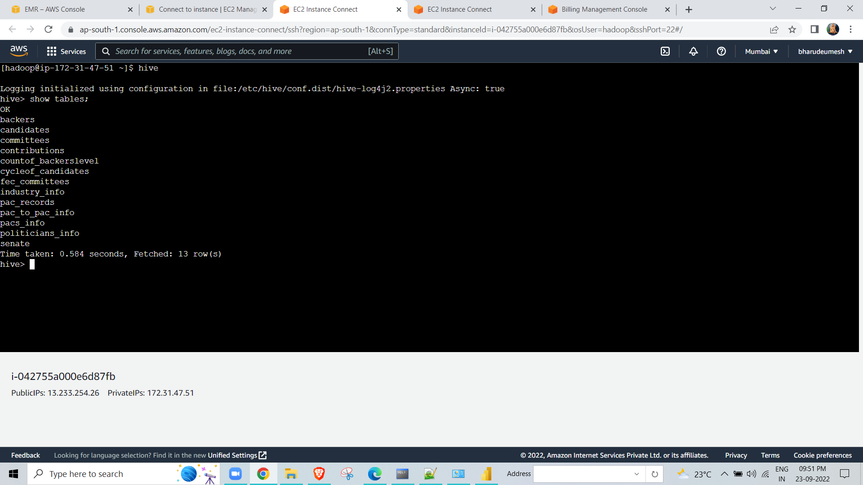
spark.sql("select party,count(party) from candidates group by party")
+--------+------------+
| party|count(party)|
+--------+------------+
| U| 1273|
| D| 25778|
| R| 27941|
| L| 3053|
| I| 4653|
+--------+------------+
Tables which are stored in hive:

Slide 21
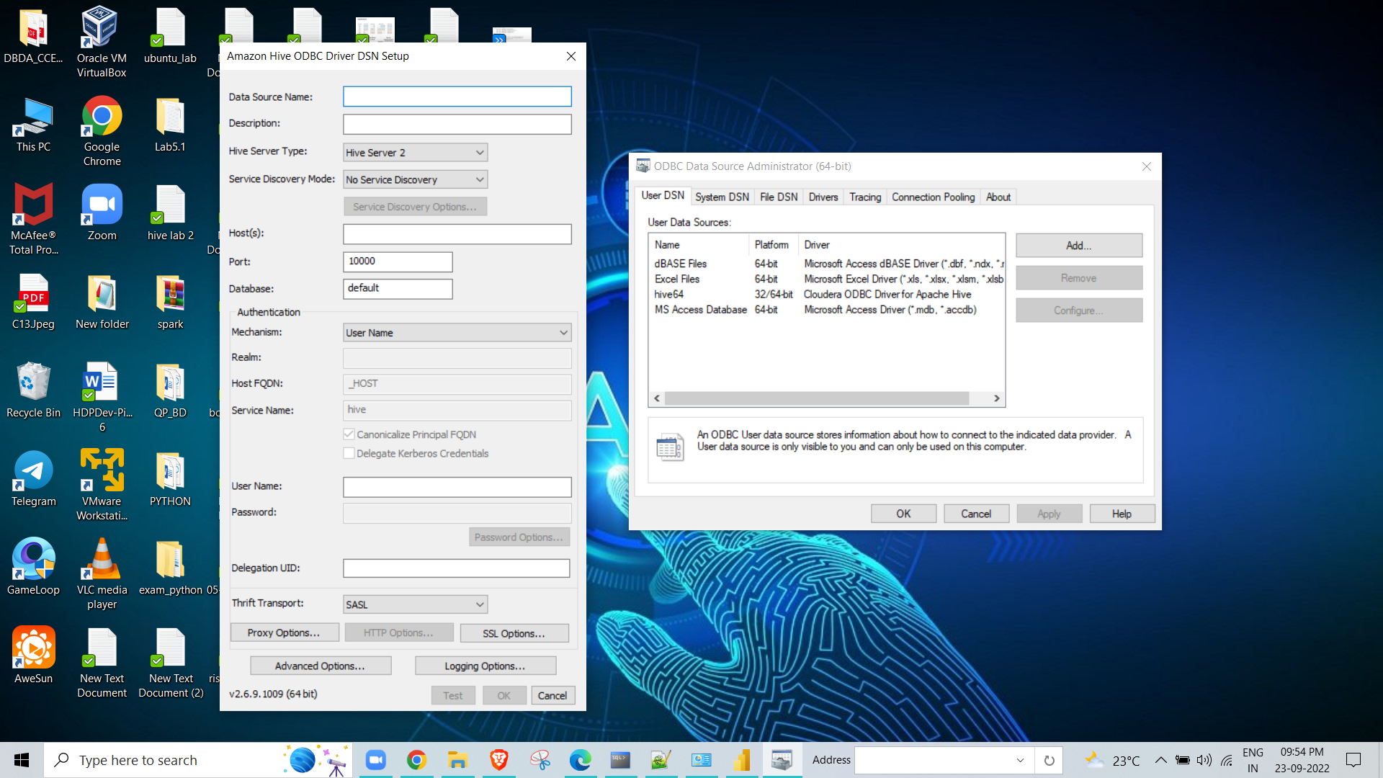
connectivity to power bi:
From the created tables we are now connecting to power bi for better Visualization and understanding below are the queries with their respective visualization.
I connected power bi using ODBC DATA SOURCES by following steps

Slide 22
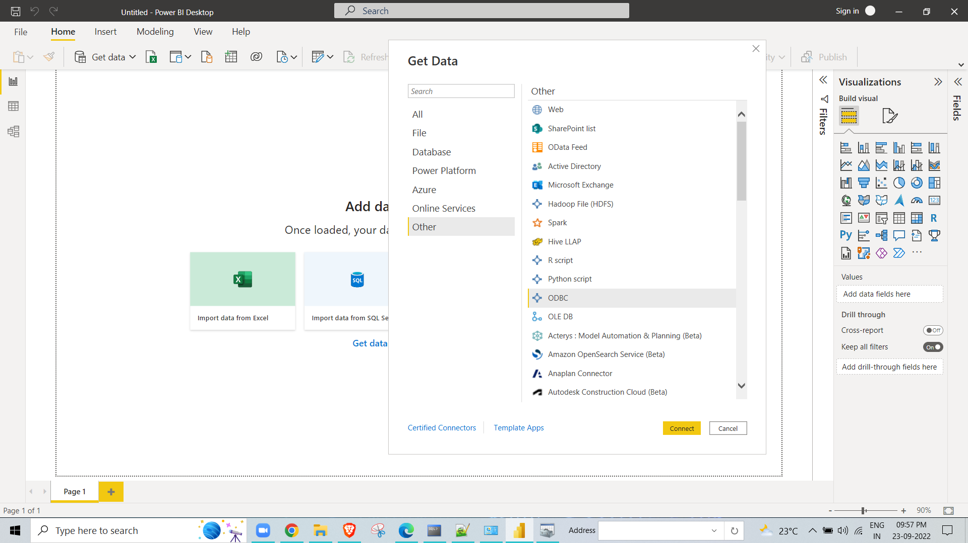
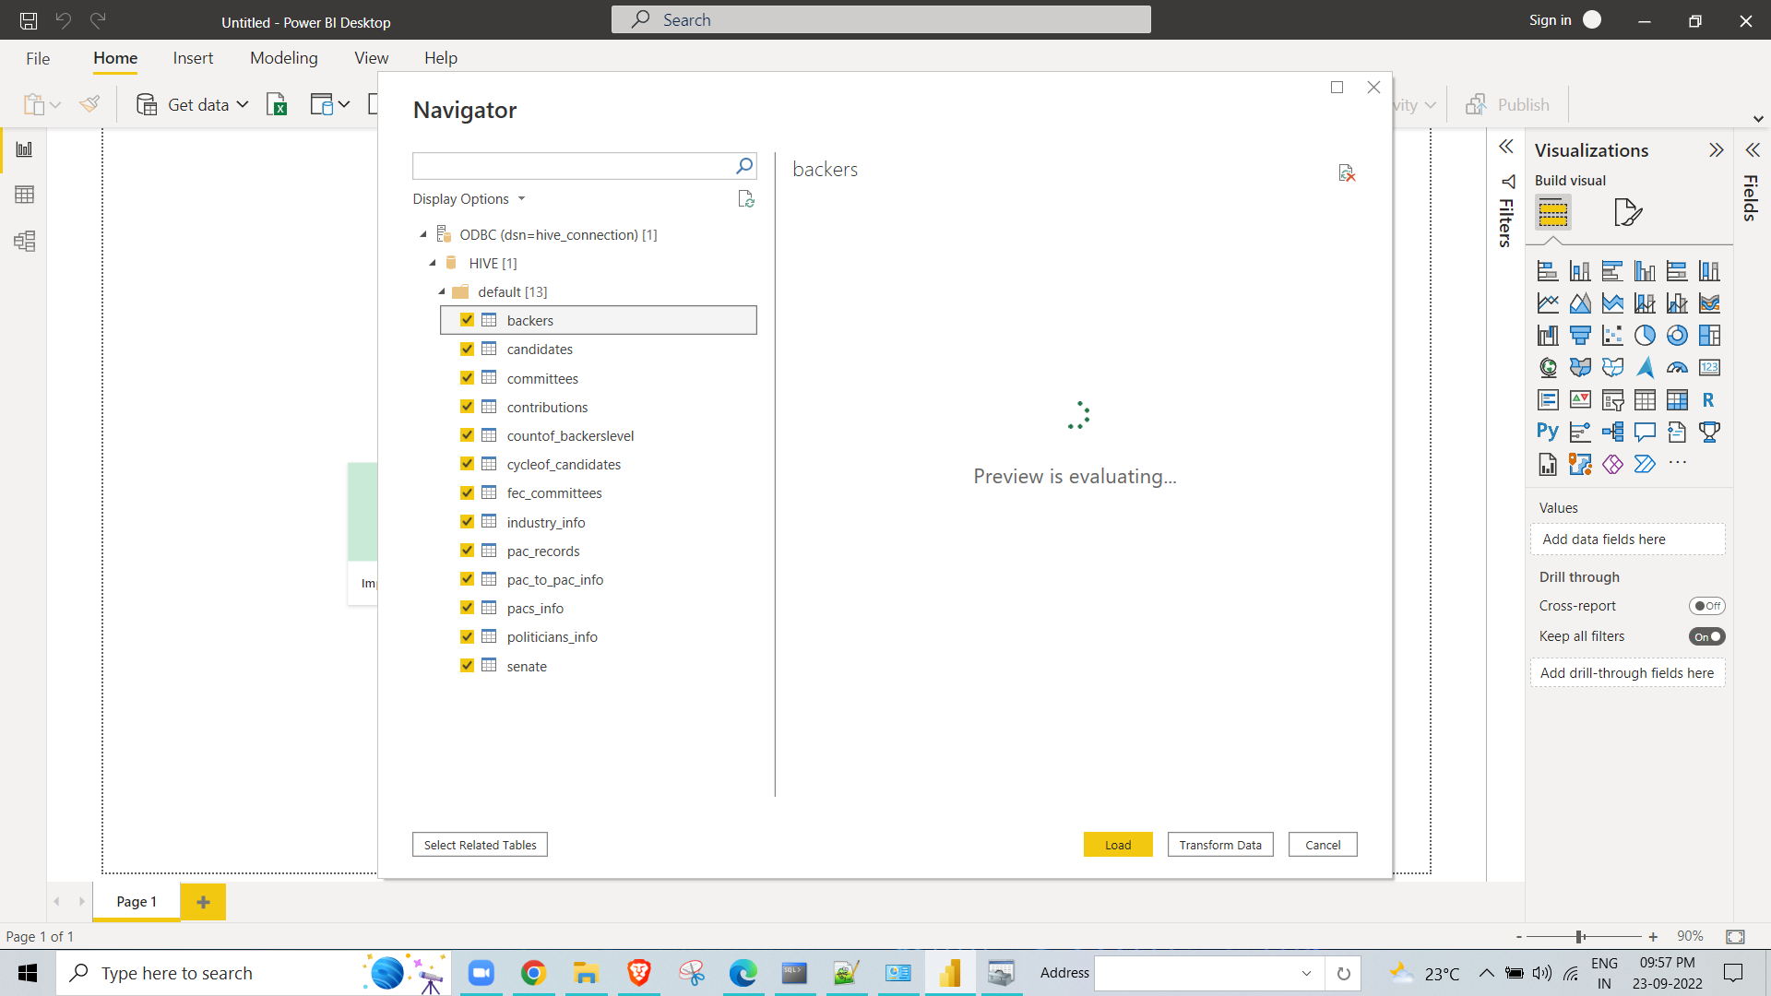

Slide 23
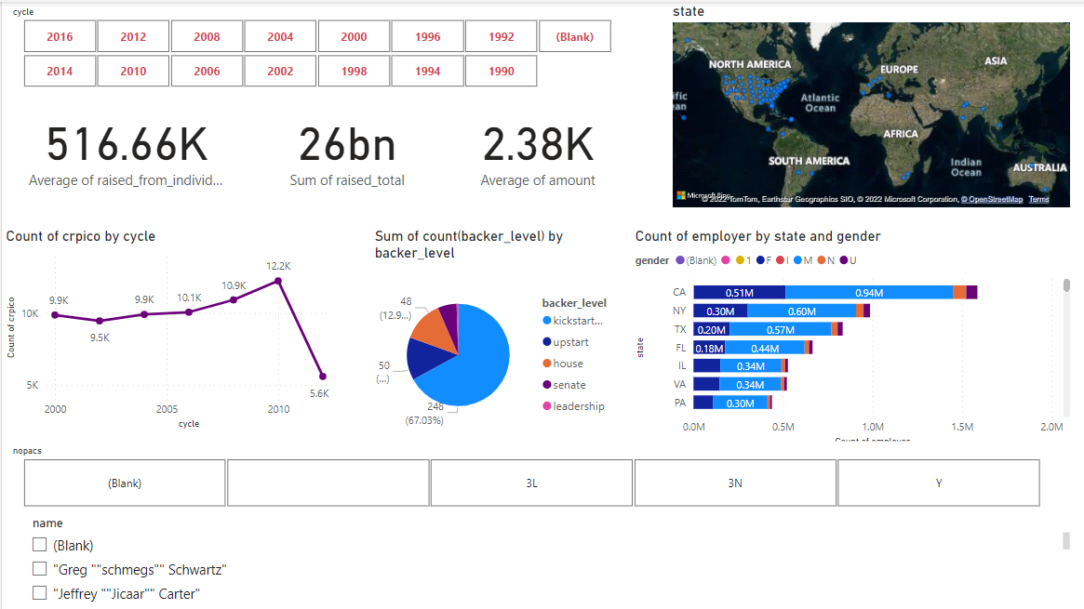
PowerBI Dashboard:

